Slide 1
Bioremediation Using Mangrove
Yukiha Shinjo Fu Sadoyama Taichi Akamine Rino Ganeko

Slide 6
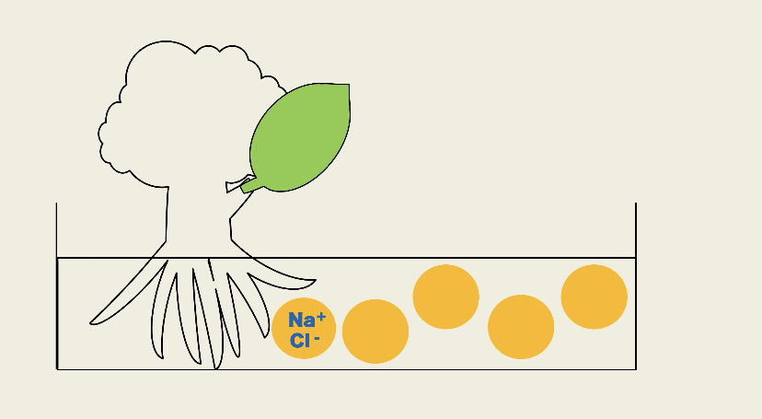
SALT TOLERANCE

Slide 8
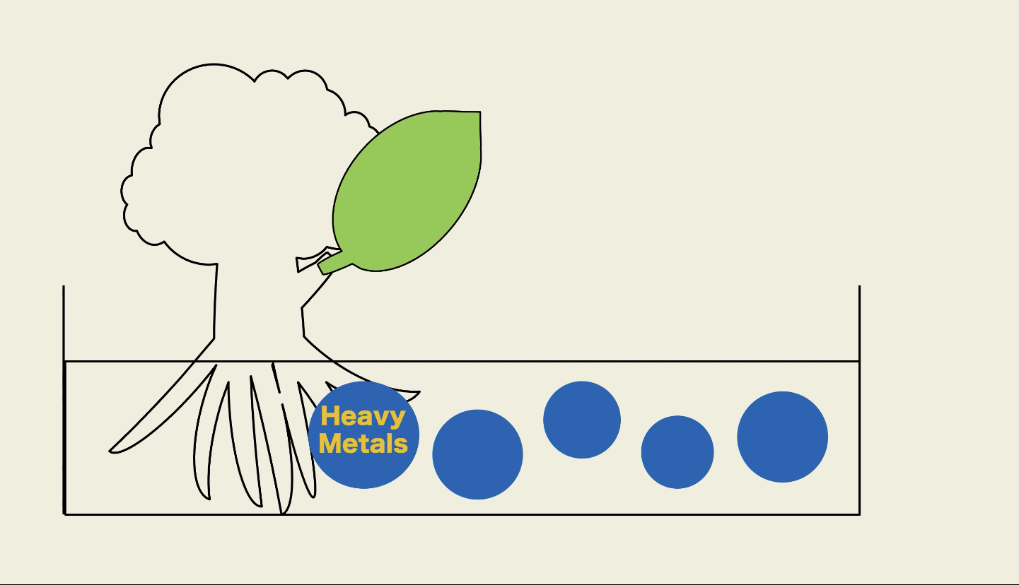
OUR HYPOTHESIS

Slide 10
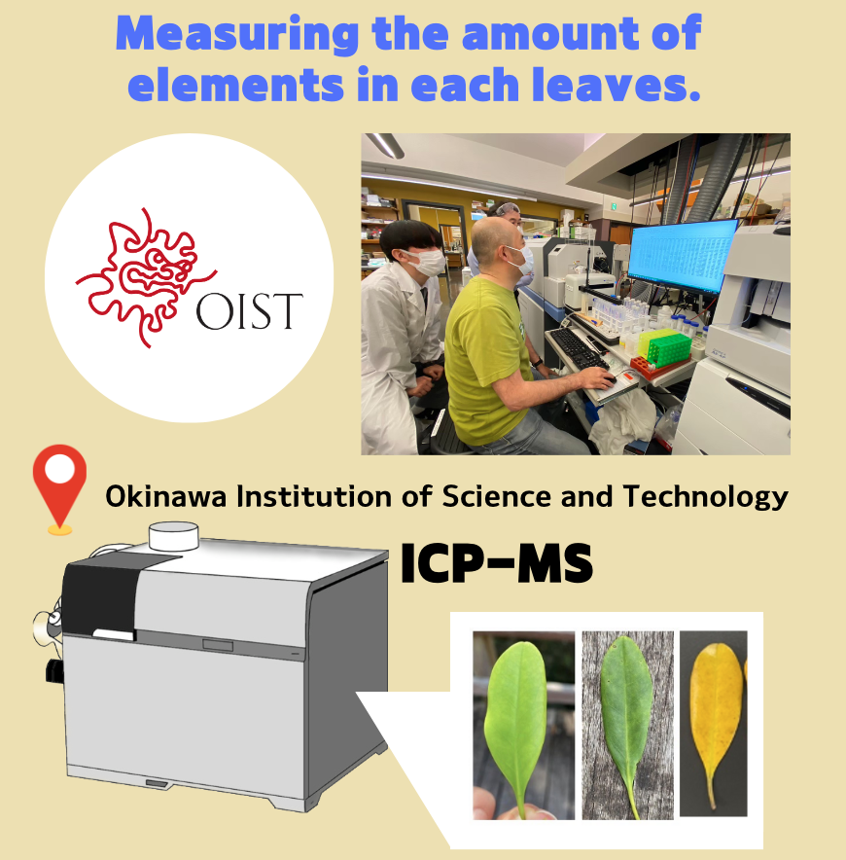

Slide 12
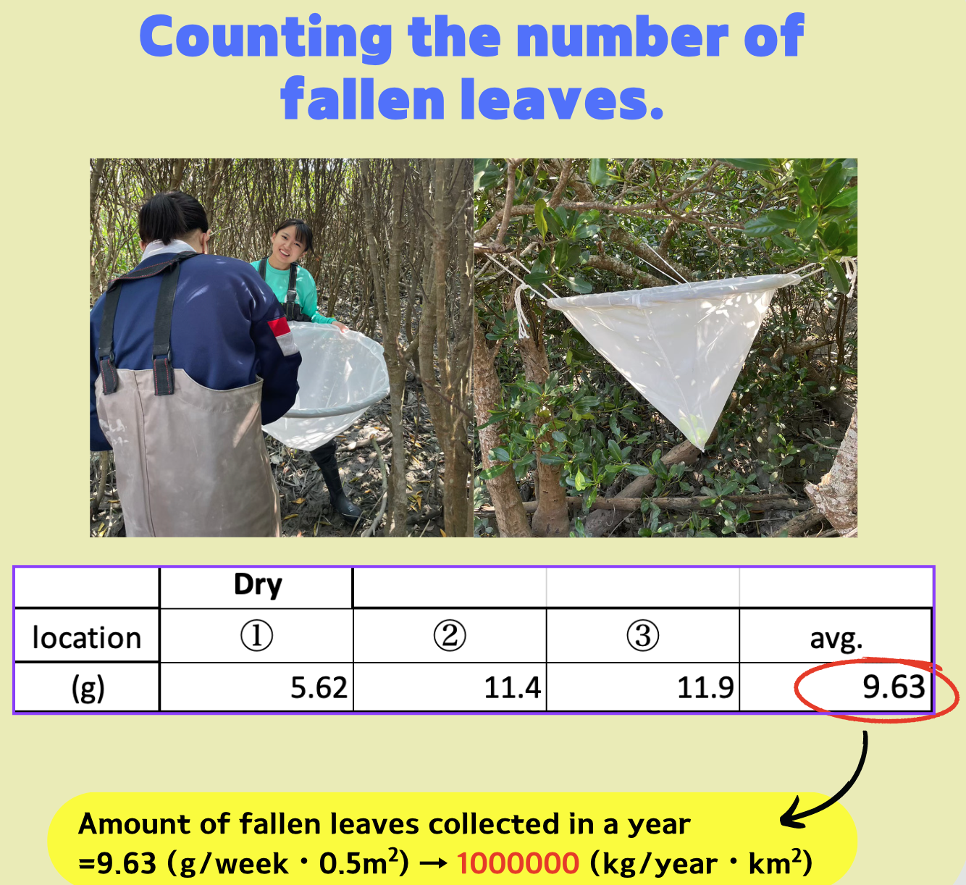

Slide 13
